Slide 1


Stock’s Relative Valuation project
All Listed Stocks in Indonesia Stock Exchange
Period 2016 – 2019
Prissilya Zefanya

Slide 2
The Background
Stock is one of the attractive and promising investments in finance. It has high risk yet high return.
Investors should consider several things in buying stock. One of the parameters is its valuation, whether the stock price is overvalued or not.

Slide 3
The Objectives
To value the stock price, relative valuation is one of the options to assess the company’s financial worth by comparing its value to its industry peers.
Hence, we aimed to facilitate the investors to find out whether their targeted stock is a good buy or not with the company’s ratios available in the company’s annual report and/or Indonesia Stock Exchange Statistics report.

Slide 4
Data processing AND MODELING SELECTION

Slide 5
The Datasets
The source
IDX Statistics Report from 2016 to 2019
The rows
2409 rows of data
The features
21 Features
Final Cleaned Datasets
2273 rows of data
7 selected features

Slide 6
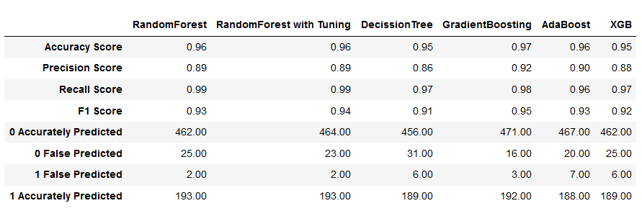
The Model Selection
Evaluation Method:
Confusion Matrix, Accuration, Precision & Recall
From the data, we choosed Gradient Boosting classifier that we got from TPOT Classifier algorithm.

Slide 7
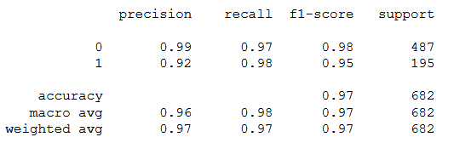
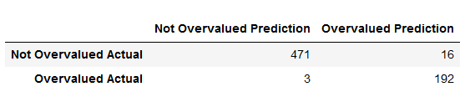
The Choosen Model Gradient Boosting Classifier
Classification Report
Confusion Matrix

Slide 8
Flask application

Slide 9
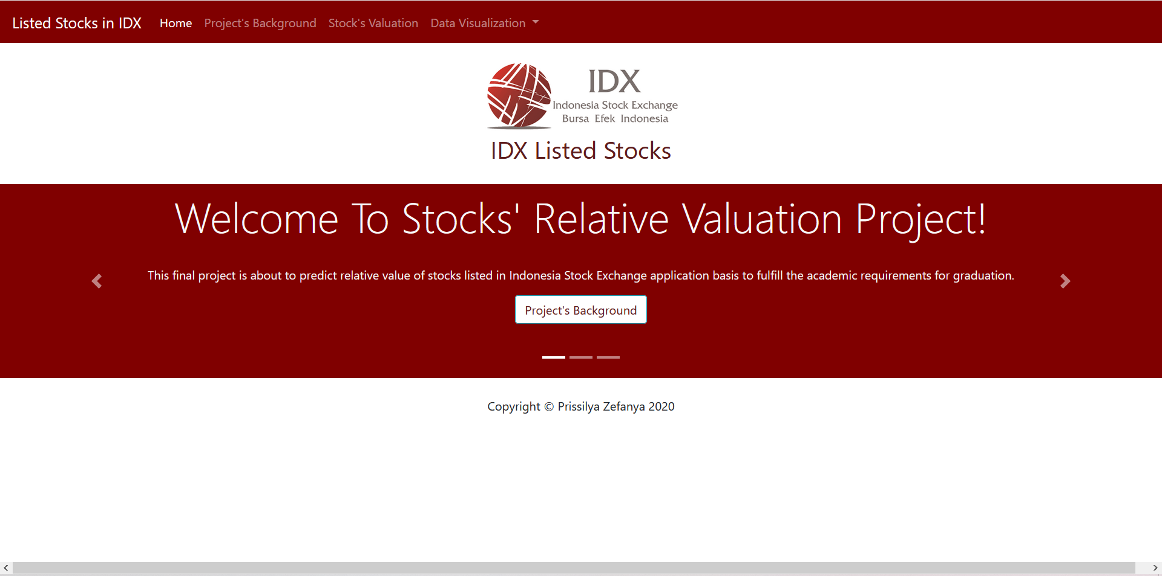
HOME INTERFACE

Slide 10
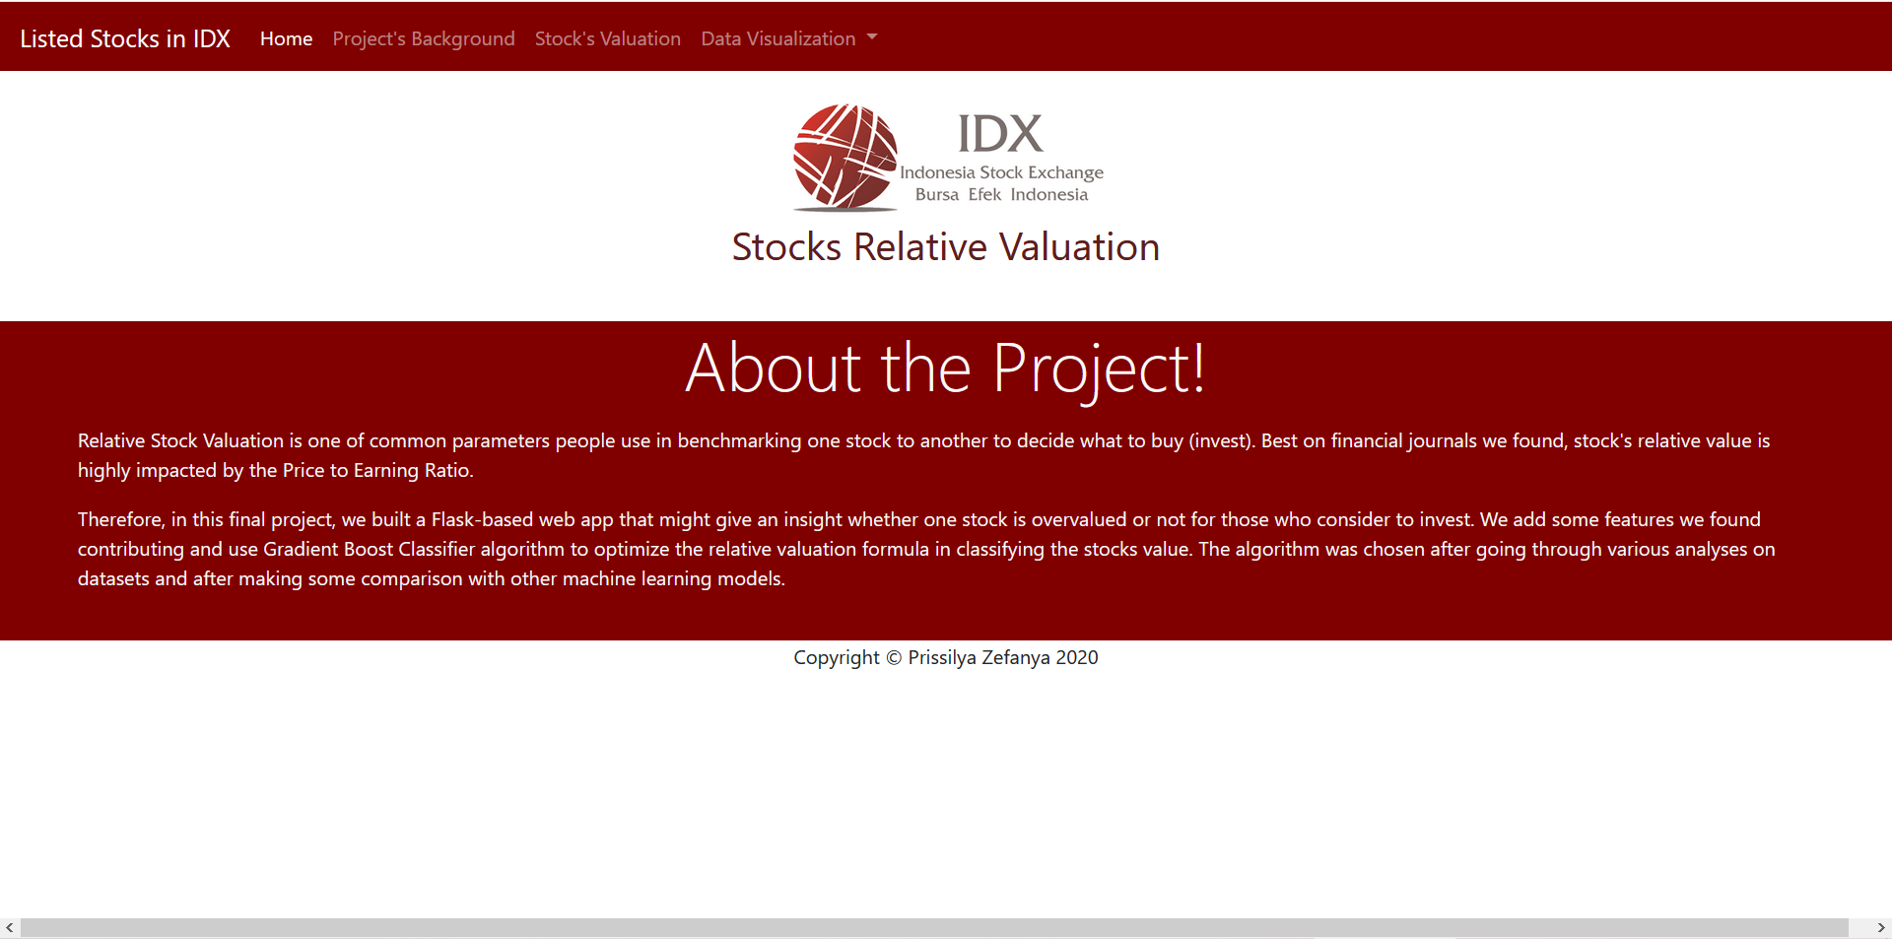
Project’s background interface

Slide 11
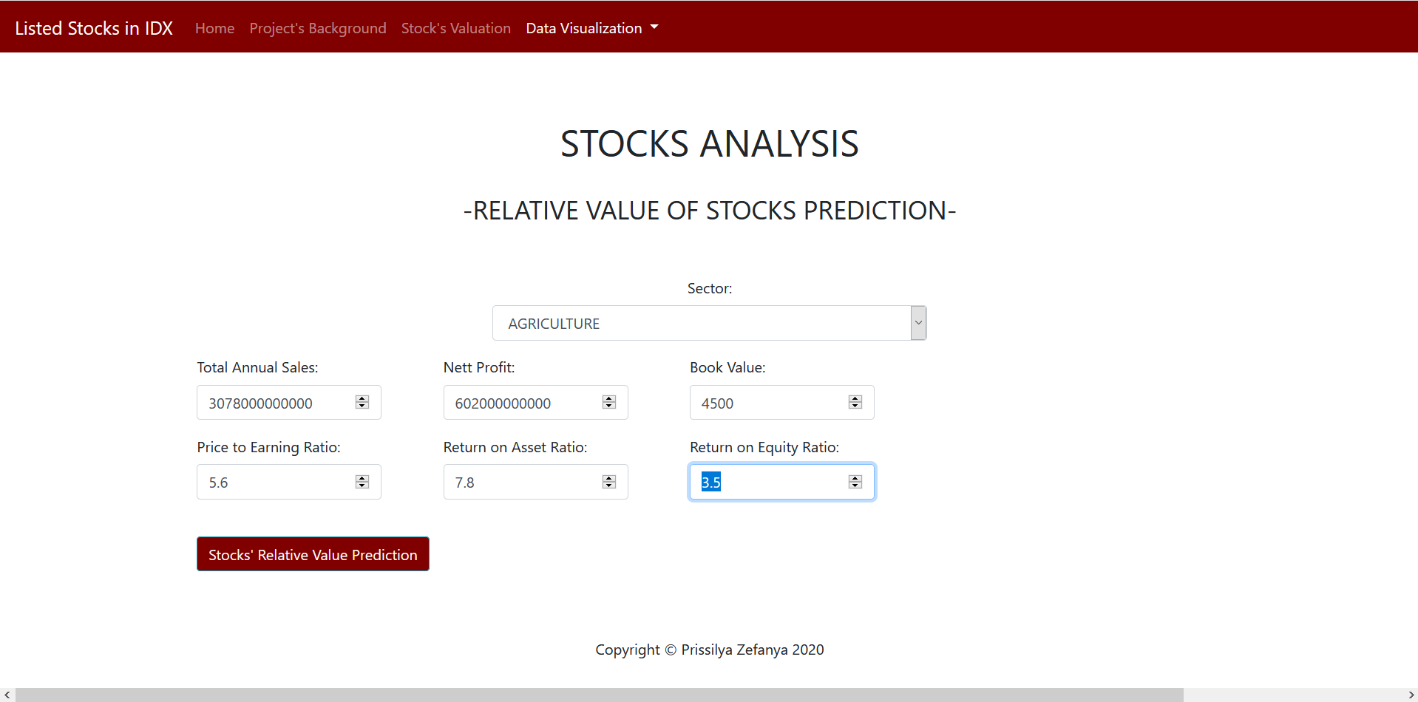
PREDICTION INTERFACE

Slide 12
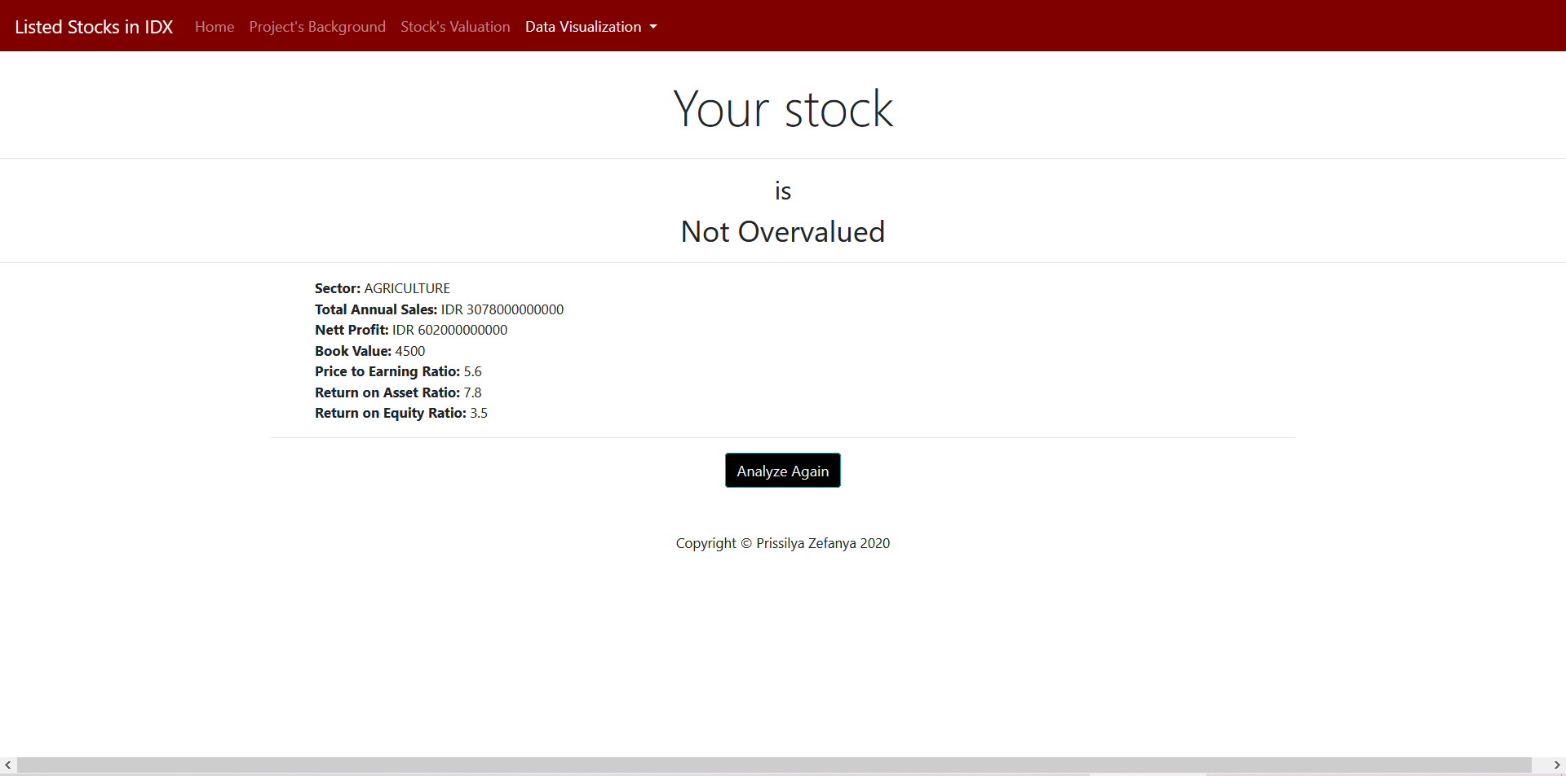
Result interface

Slide 13
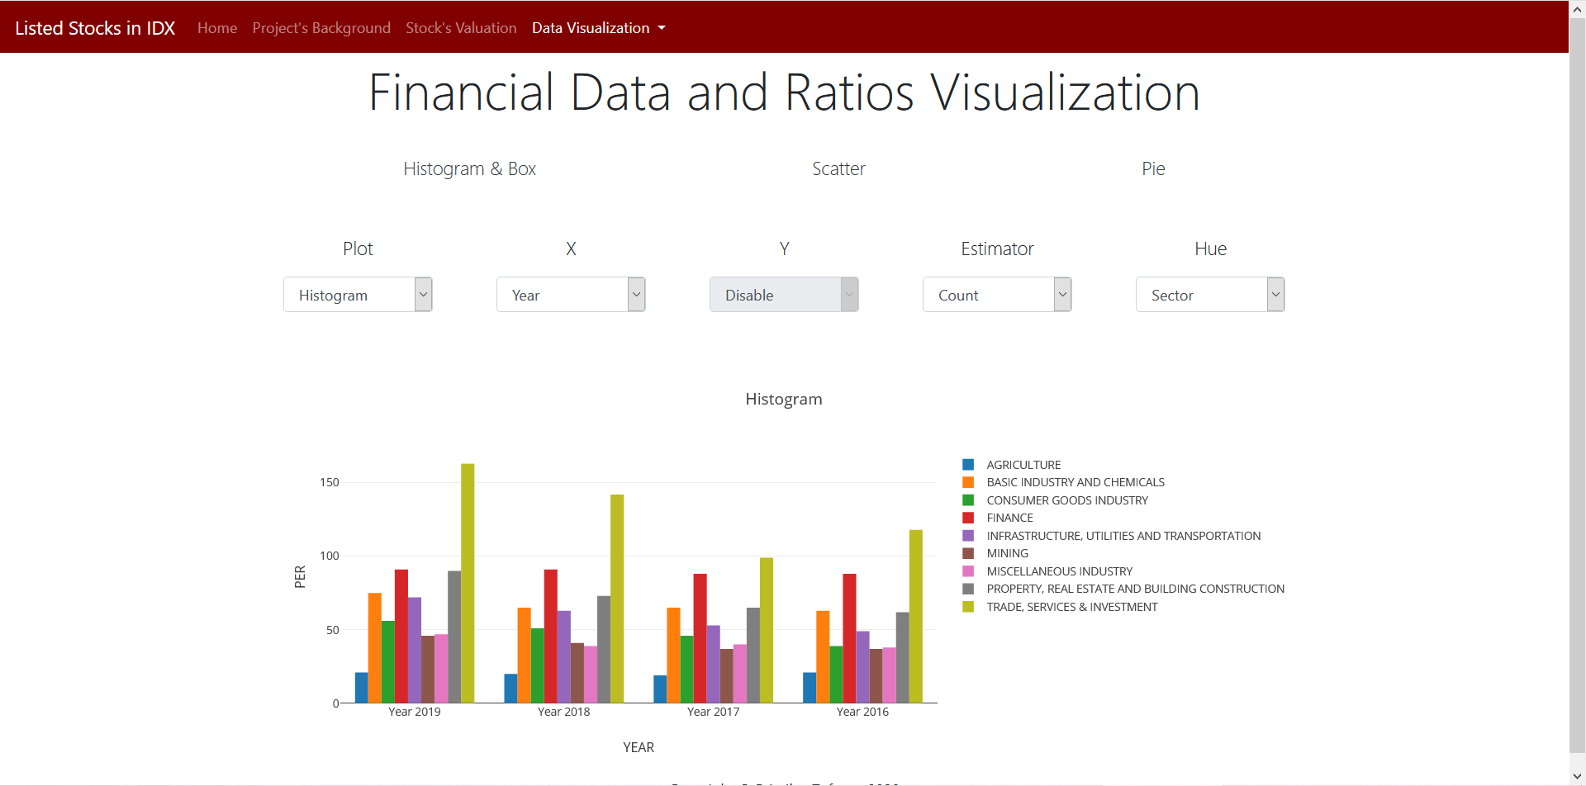
Data visualization interface histogram

Slide 14
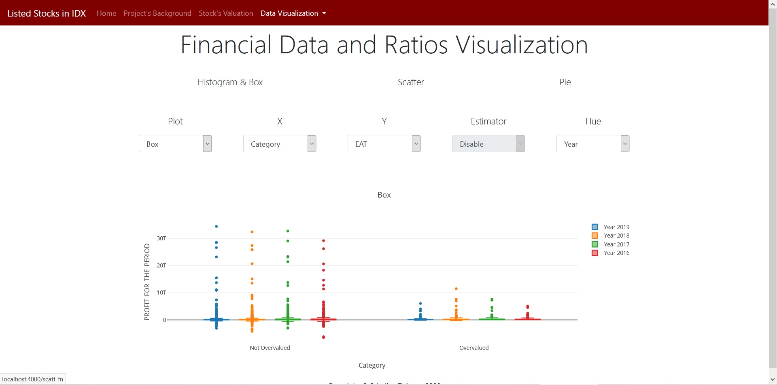
Data visualization interface boxplot

Slide 15
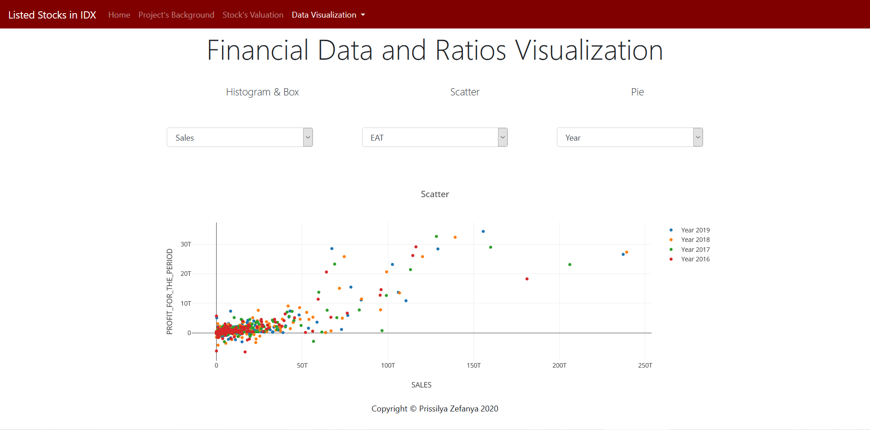
Data visualization interface scatter

Slide 16
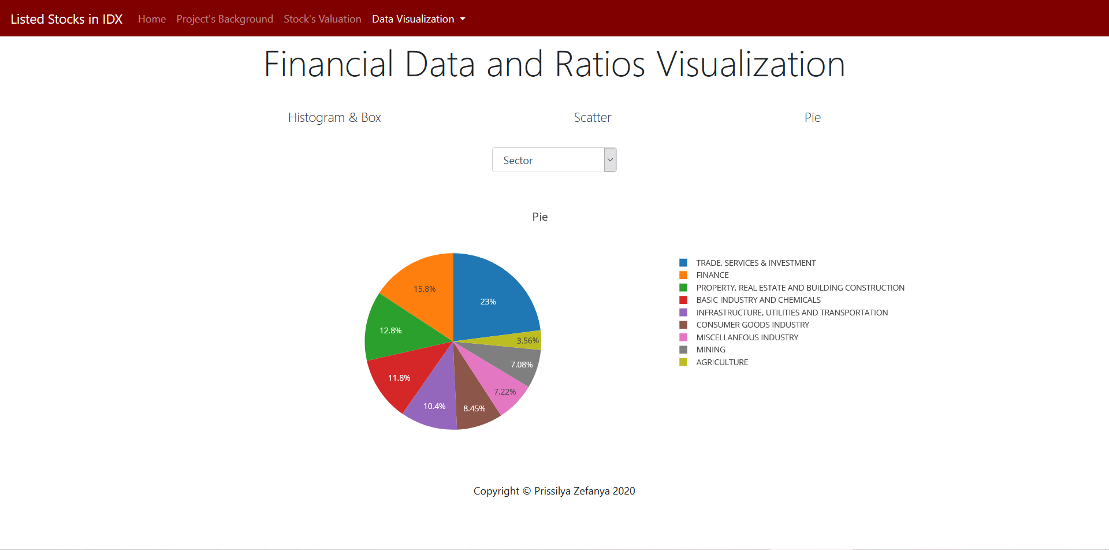
Data visualization interface pie

Slide 17
CONCLUSION AND SUGGESTION

Slide 18
CONCLUSION
Relative valuation generally only use p/e ratio to asses whether the stock is overvalued or not. But, we found that total sales, net profit, book value, roa and roe are also contributing enough to the valuation.
The gradient boosting classifier algorithm also could predict the valuation with the accuracy score up to 97%.

Slide 19
suggestion
It would be better if the period of the datasets could be longer more than 5 years to get the better and more accurate prediction

Slide 20
Thank you

